Slide 1

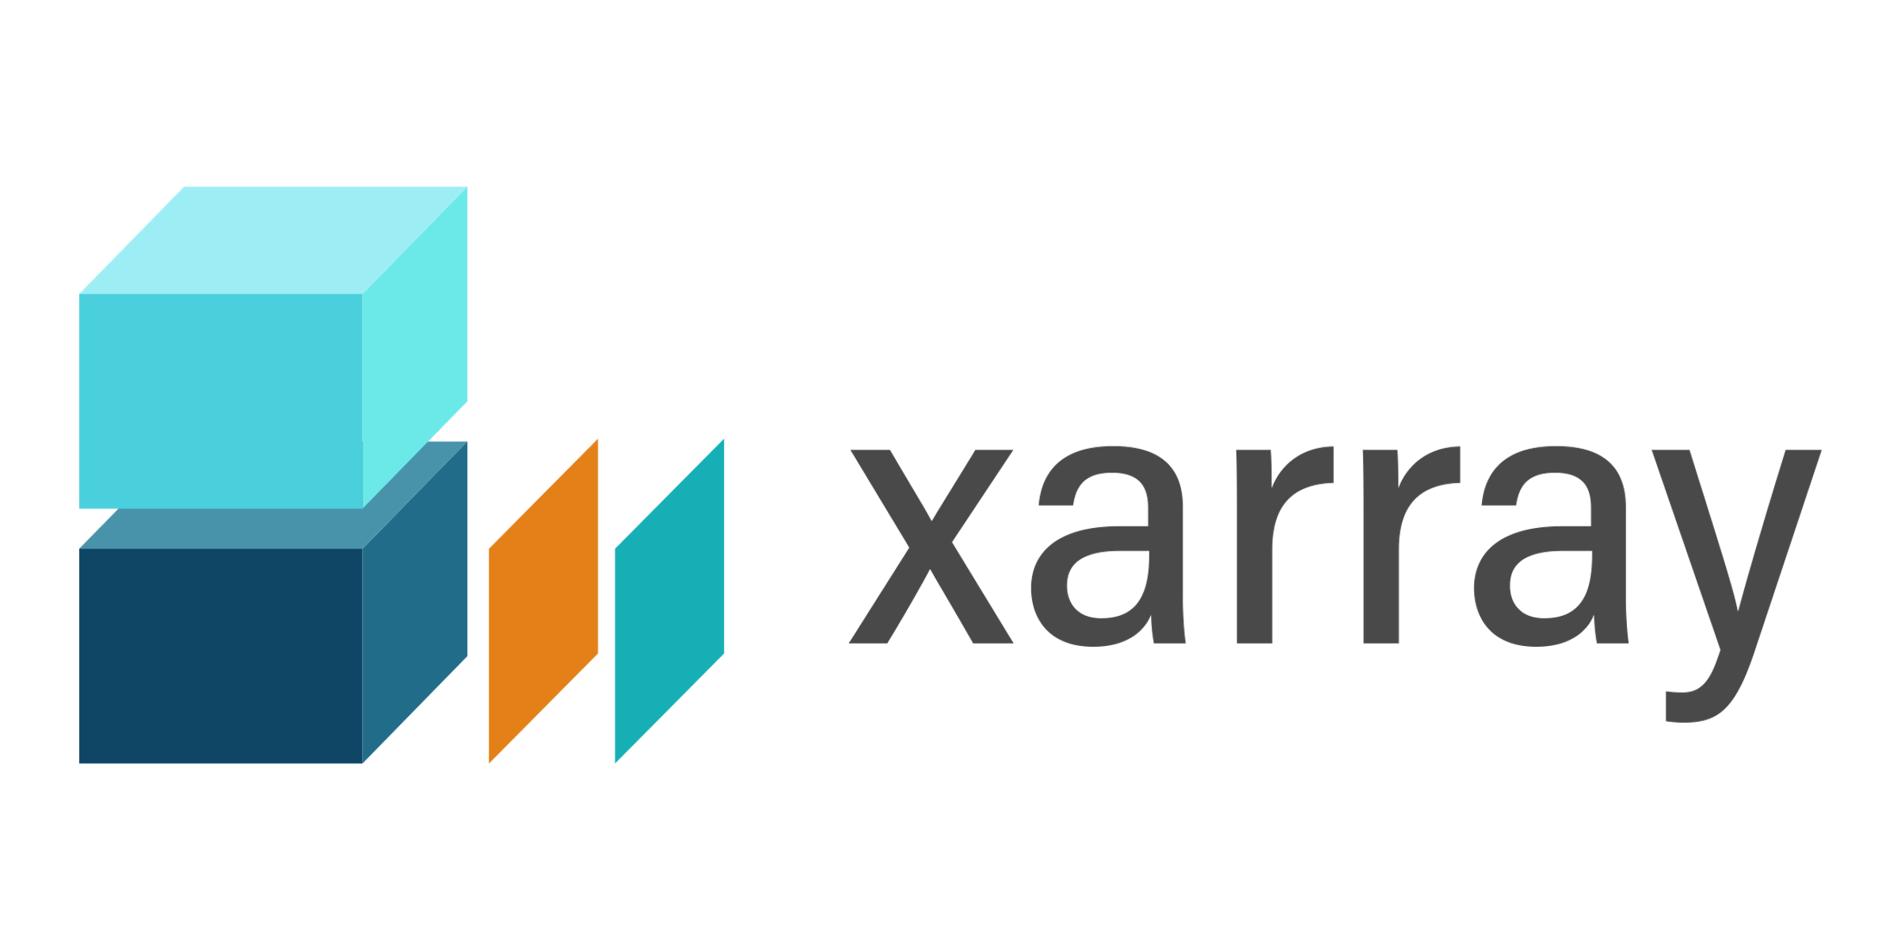

Python for data analysis in geosciences
General introduction

Slide 2

ATTENTION !
Signez la fiche de présence
Est-ce que tout le monde a les TPs et les données?

Slide 3
Today’s objectives
Main uses
of pandas and xarray
Analyse geoscientific data in an efficient, fast and easily sharable way using python
Scaling potential for
huge datasets

Slide 4

Programme
PANDAS
Matin: pandas
General introduction
Objects
Operations
Plotting
Timeseries
Cours
TP
Cours
TP
Cours
TP
Cours
TP
XARRAY
Arpès-midi: xarray
Objects
Plotting
Operations
Dask
Cours
TP
Cours
TP
Cours
TP
Cours + Démo

Slide 5

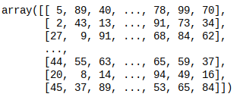
Back to basic: numpy arrays
Multi-dimensionnal arrays
Vectorized operations
  array1 + array2
Statistical operations
  np.mean(array)

Slide 6
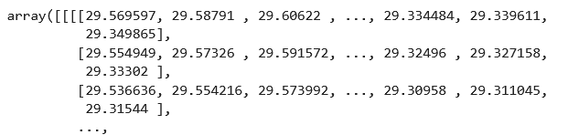
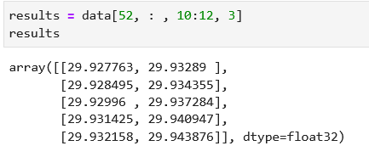

Back to basic: numpy arrays
Access to data not really intuitive !

Slide 7
Share functionnality 1: indexing
pandas/xarray wrapping
Numpy array
Variable names
Height (cm)
Weight (kg)
Life expectancy (years)
Indices
Elf
200
80
1000
Dwarf
120
120
300
Hobbit
110
40
120
Select data using indices
Access variable/dimensions by their explicit names

Slide 8
Share functionnality 2: many formats for reading/writing
Tabular format
csv
excel (xls, xlsx)
txt
json
…
Grid format
Netcdf
GRIB
geoTIFF
zarr
…

Slide 9
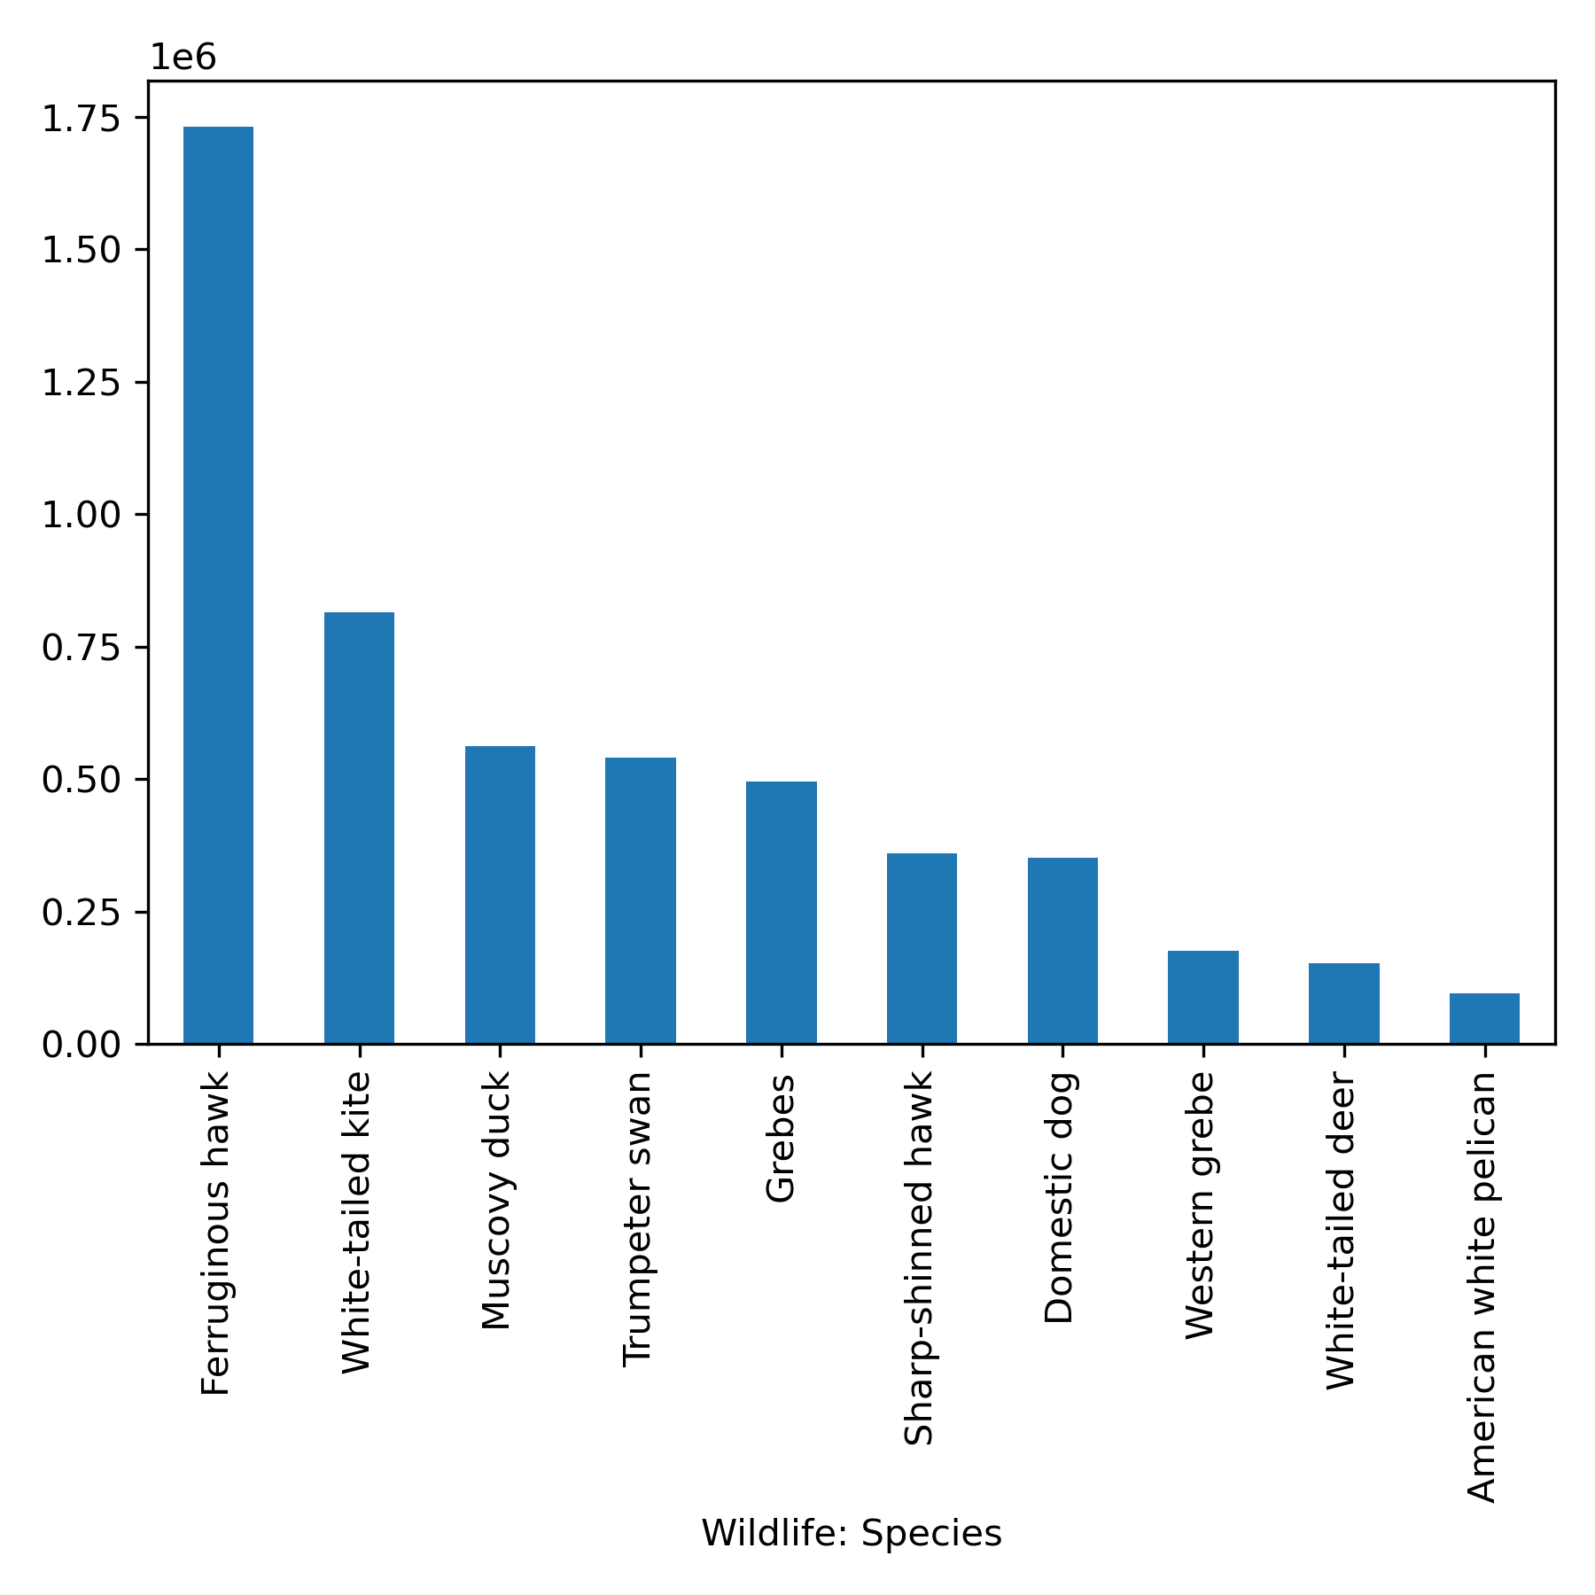
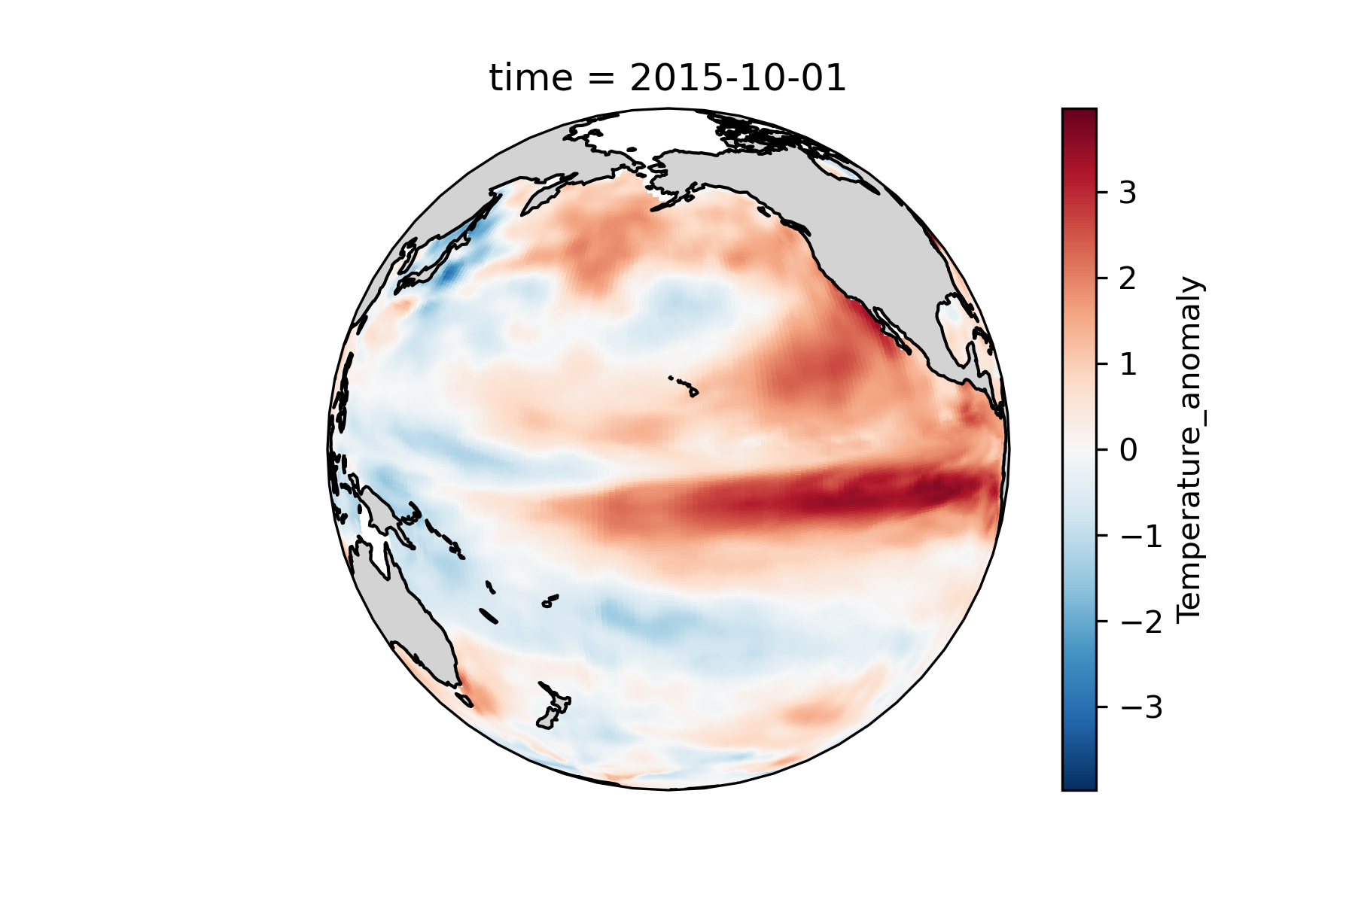
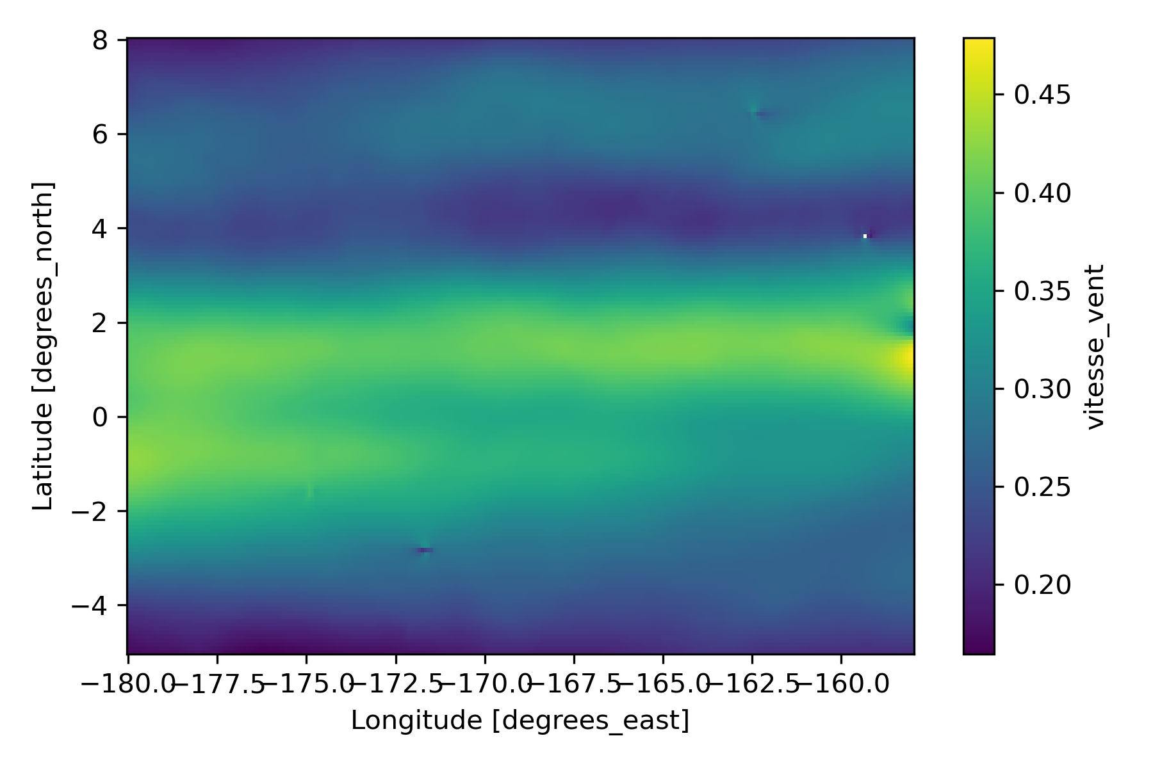
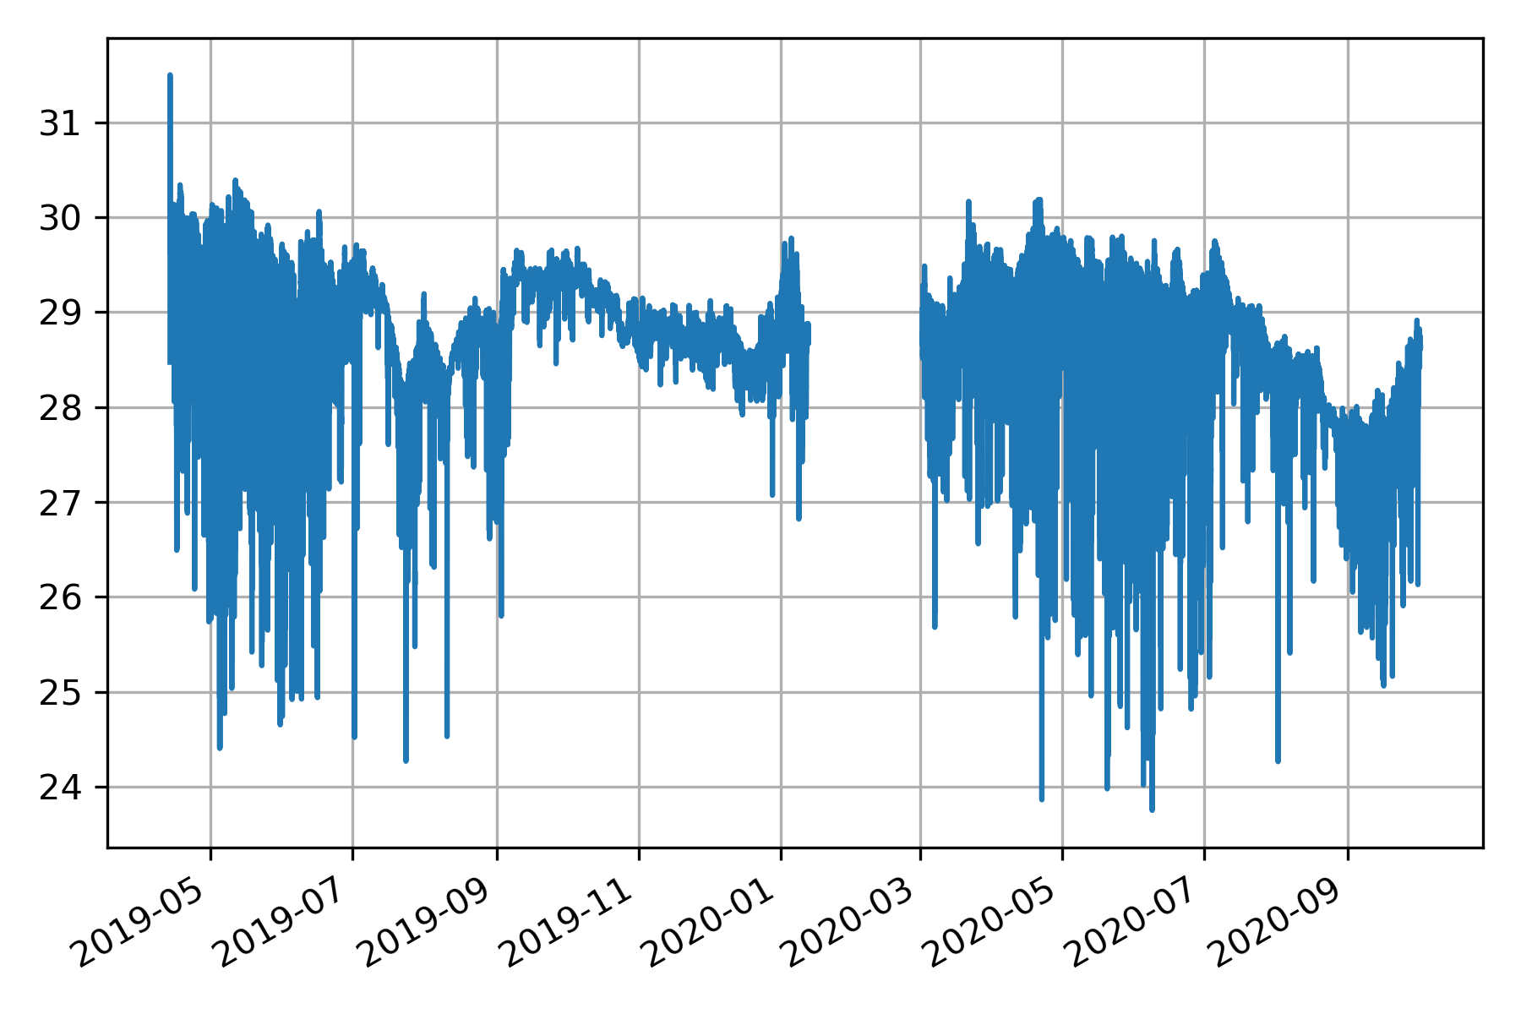
Share functionnality 3: easy plotting
Integrated with matplotlib (and many other backends like hvplot, plotly, …)
Categorical plots
Time series
Maps

Slide 10
Some differences
Better for one dimension data
Different data types possible (string, datetime, int, float, …)
More methods available
Generalising pandas with several dimensions
Better for geographical data with 3-4 dimensions
Great for categorical data/timeseries
Gridded data climate/ocean/atmosphere/satellite

Slide 11
Useful links
https://pandas.pydata.org/
https://docs.xarray.dev/en/stable/
https://gallery.pangeo.io/
https://www.dask.org/

Slide 12
Any question?

Slide 13
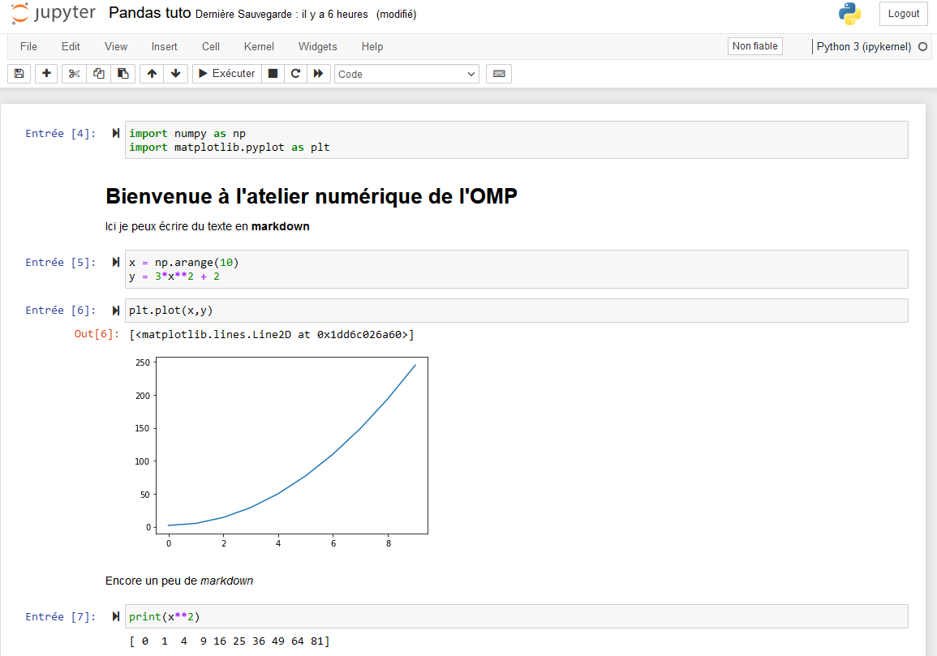
Quick introduction to jupyter notebooks
Cells
Code
Markdown
Outputs

